Slide 1
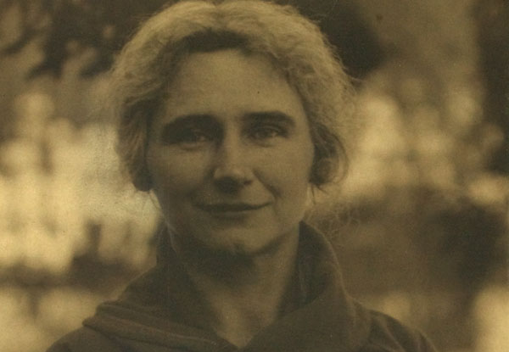

Lilian Sandburg
(1883-1977)

Slide 2
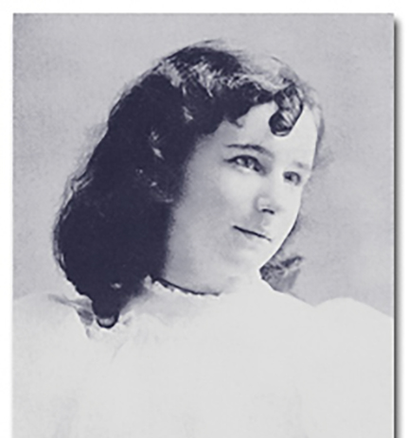

2
Born Lilian Steichen on May 1, 1883, in Hancock, Michigan.
She was a first-generation American as her parents were immigrants from Luxembourg. A small European country, surrounded by Belgium, France and Germany.
Due to her family background, she was knowledgeable in Luxembourgish, German and English.

Slide 3
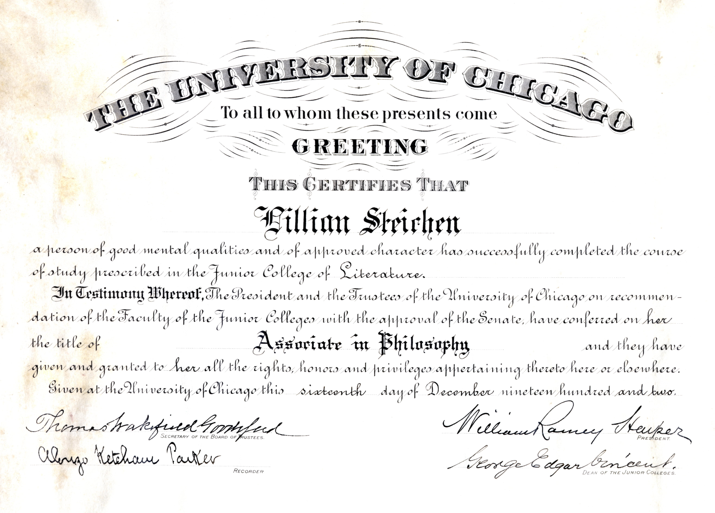
3
Rebelled against her father’s insistence that she quit school as a young girl to work at her mother’s shop.
Went to Canada for a year to study at Ursuline convent, where she was able to pass all the exams before graduating high school to attend The University of Illinois.
She eventually transferred to The University of Chicago, where she graduated with a degree in Philosophy. A rarity as not many women attended college during this time.

Slide 4
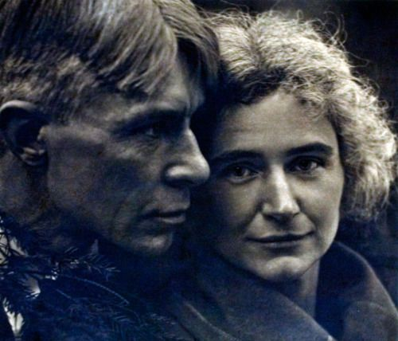
4
Joined the Wisconsin Social Democratic Party. Where she fought for the rights of women and the laboring class. This is also where she met her future husband, Carl Sandburg.
She was a strong advocate for the Wisconsin Tuberculosis society.
Carl & Lilian married on June 13, 1908.

Slide 5
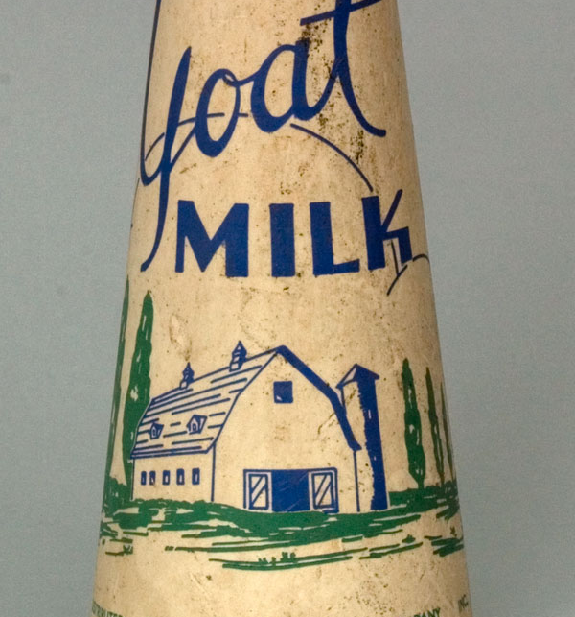
5
Soon after their marriage, Lilian began to study poultry farming at the local library. After their move to Michigan, she began to raise chickens.
Her experience raising chickens led her to an interest in dairy goats.
Lilian purchased her first dairy goat in 1935 and began to research the benefits of goat milk.

Slide 6
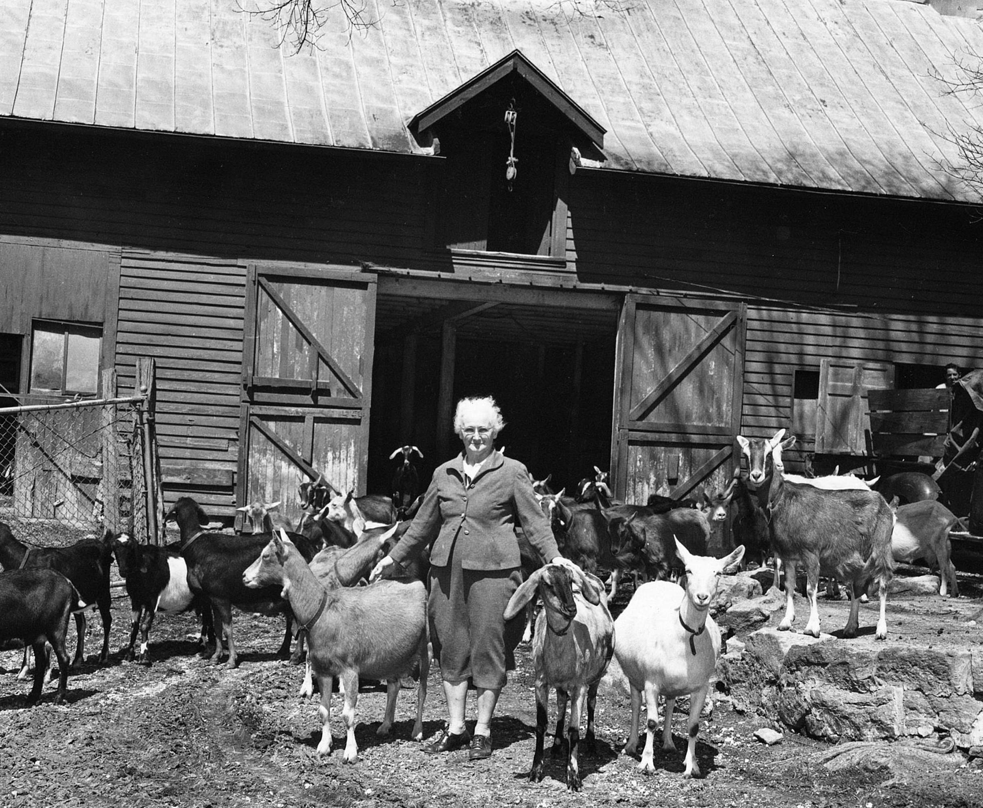
6
Lilian became an amateur geneticist, by breeding goat bloodlines that would produce the most milk.
In 1960, one of Lilian’s goats, Jennifer II set the world record for the most milk produced in a single year.
In 1964, Lilian received an award for outstanding service to the dairy goat industry.

Slide 7
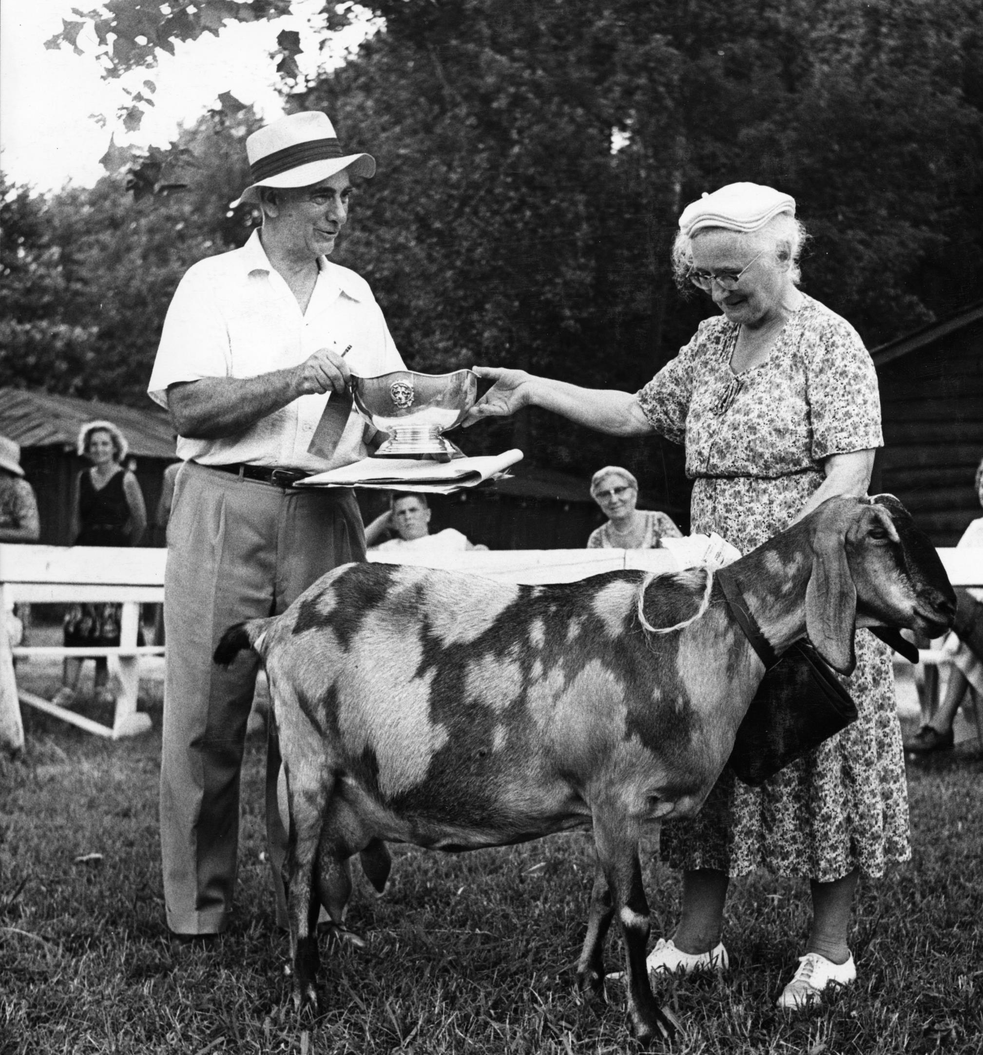
7
Today, Lilian is credited with being one of the founders of the American Dairy Goat Association. (ADGA)

